Slide 1
Discrete Event Simulation
Event-Oriented Simulations

Slide 2
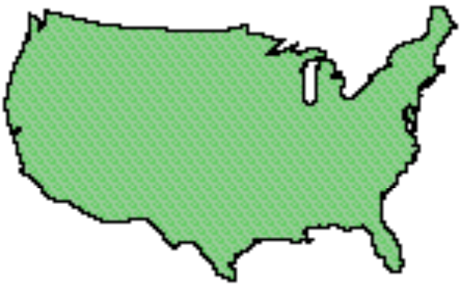
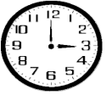
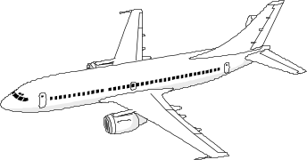


Time
physical system: the actual or imagined system being modeled
simulation: a system that emulates the behavior of a physical system
physical system
simulation
main()
{ ...
double clock;
...
}
physical time: time in the physical system
  Noon, December 31, 1999 to noon January 1, 2000
simulation time: representation of physical time within the simulation
  floating point values in interval [0.0, 24.0]
wallclock time: time during the execution of the simulation, usually output from a hardware clock
  9:00 to 9:15 AM on September 10, 1999

Slide 3
Simulation Time
Simulation time is defined as a totally ordered set of values where each value represents an instant of time in the physical system being modeled.
For any two values of simulation time T₁ representing instant P₁, and T₂ representing P₂:
Correct ordering of time instants
  If T₁ < T₂, then P₁ occurs before P₂
  9.0 represents 9 PM, 10.5 represents 10:30 PM
Correct representation of time durations
  T₂ - T₁ = k (P₂ - P₁) for some constant k
  1.0 in simulation time represents 1 hour of physical time

Slide 4
Paced vs. Unpaced Execution
Modes of execution
As-fast-as-possible execution (unpaced): no fixed relationship necessarily exists between advances in simulation time and advances in wallclock time
Real-time execution (paced): each advance in simulation time is paced to occur in synchrony with an equivalent advance in wallclock time
Scaled real-time execution (paced): each advance in simulation time is paced to occur in synchrony with S * an equivalent advance in wallclock time (e.g., 2x wallclock time)
Simulation Time = W2S(W) = T₀ + S * (W - W₀)
W = wallclock time; S = scale factor
W₀ (T₀) = wallclock (simulation) time at start of simulation
(assume simulation and wallclock time use same time units)

Slide 5
Discrete Event Simulation
Discrete event simulation: computer model for a system where changes in the state of the system occur at discrete points in simulation time.
Fundamental concepts:
system state (state variables)
state transitions (events)
A DES computation can be viewed as a sequence of event computations, with each event computation is assigned a (simulation time) time stamp
Each event computation can
modify state variables
schedule new events

Slide 6
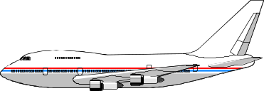
Discrete Event Simulation Computation
example: air traffic at an airport
events: aircraft arrival, landing, departure
arrival
8:00
schedules
departure
9:15
arrival
9:30
processed event
current event
unprocessed event
landed
8:05
schedules
simulation time
Unprocessed events are stored in a pending event list
Events are processed in time stamp order

Slide 7
Discrete Event Simulation System
model of the physical system
Simulation Application
state variables
code modeling system behavior
I/O and user interface software
calls to
schedule
events
calls to event
handlers
independent of the simulation application
Simulation Executive
event list management
managing advances in simulation time

Slide 8
Event-Oriented World View
  Event handler procedures
state variables
Arrival Event
{
…
}
Landed Event
{
…
}
Departure Event
{
…
}
Integer: InTheAir;
Integer: OnTheGround;
Boolean: RunwayFree;
Simulation application
Simulation executive
  Event processing loop
Now = 8:45
While (simulation not finished)
E = smallest time stamp event in PEL
Remove E from PEL
Now := time stamp of E
call event handler procedure
Pending Event List (PEL)
9:00
10:10
9:16

Slide 9
Example: Air traffic at an Airport
Model aircraft arrivals and departures, arrival queueing
Single runway for incoming aircraft, ignore departure queueing
R = time runway is used for each landing aircraft (constant)
G = time required on the ground before departing (constant)
State:
Now: current simulation time
InTheAir: number of aircraft landing or waiting to land
OnTheGround: number of landed aircraft
RunwayFree: Boolean, true if runway available
Events:
Arrival: denotes aircraft arriving in air space of airport
Landed: denotes aircraft landing
Departure: denotes aircraft leaving

Slide 10
Arrival Events
New aircraft arrives at airport. If the runway is free, it will begin
to land. Otherwise, the aircraft must circle, and wait to land.
R = time runway is used for each landing aircraft
G = time required on the ground before departing
Now: current simulation time
InTheAir: number of aircraft landing or waiting to land
OnTheGround: number of landed aircraft
RunwayFree: Boolean, true if runway available
Arrival Event:
InTheAir := InTheAir+1;
If (RunwayFree)
RunwayFree:=FALSE;
Schedule Landed event @ Now + R;

Slide 11
Landed Event
An aircraft has completed its landing.
R = time runway is used for each landing aircraft
G = time required on the ground before departing
Now: current simulation time
InTheAir: number of aircraft landing or waiting to land
OnTheGround: number of landed aircraft
RunwayFree: Boolean, true if runway available
Landed Event:
InTheAir:=InTheAir-1;
OnTheGround:=OnTheGround+1;
Schedule Departure event @ Now + G;
If (InTheAir>0)
Schedule Landed event @ Now + R;
Else
RunwayFree := TRUE;

Slide 12
Departure Event
An aircraft now on the ground departs for a new
destination.
R = time runway is used for each landing aircraft
G = time required on the ground before departing
Now: current simulation time
InTheAir: number of aircraft landing or waiting to land
OnTheGround: number of landed aircraft
RunwayFree: Boolean, true if runway available
Departure Event:
OnTheGround := OnTheGround - 1;

Slide 13
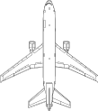
Execution Example
State
Variables
R=3
G=4
InTheAir
0
1
2
1
0
OnTheGround
0
1
2
1
0
RunwayFree
true
false
true
0
1
2
3
4
5
6
7
8
9
10
11
Simulation Time
Processing:
Arrival F1
Arrival F2
Landed F1
Landed F2
Depart F1
Depart F2
Time
Event
Time
Event
Time
Event
Time
Event
Time
Event
Time
Event
Time
Event
1 Arrival F1
3 Arrival F2
3 Arrival F2
4 Landed F1
4 Landed F1
7 Landed F2
8 Depart F1
8 Depart F1
11 Depart F2
11 Depart F2
Now=0
Now=1
Now=3
Now=4
Now=7
Now=8
Now=11

Slide 14
Summary
Time
  Important to distinguish among simulation time, wallclock time, and time in the physical system
  Paced execution (e.g., immersive virtual environments) vs. unpaced execution (e.g., simulations to analyze systems)
DES computation: sequence of event computations
  Modify state variables
  Schedule new events
DES System = model + simulation executive
Data structures
  Pending event list to hold unprocessed events
  State variables
  Simulation time clock variable
Program (Code)
  Main event processing loop
  Event procedures
  Events processed in time stamp order

